Slide 1


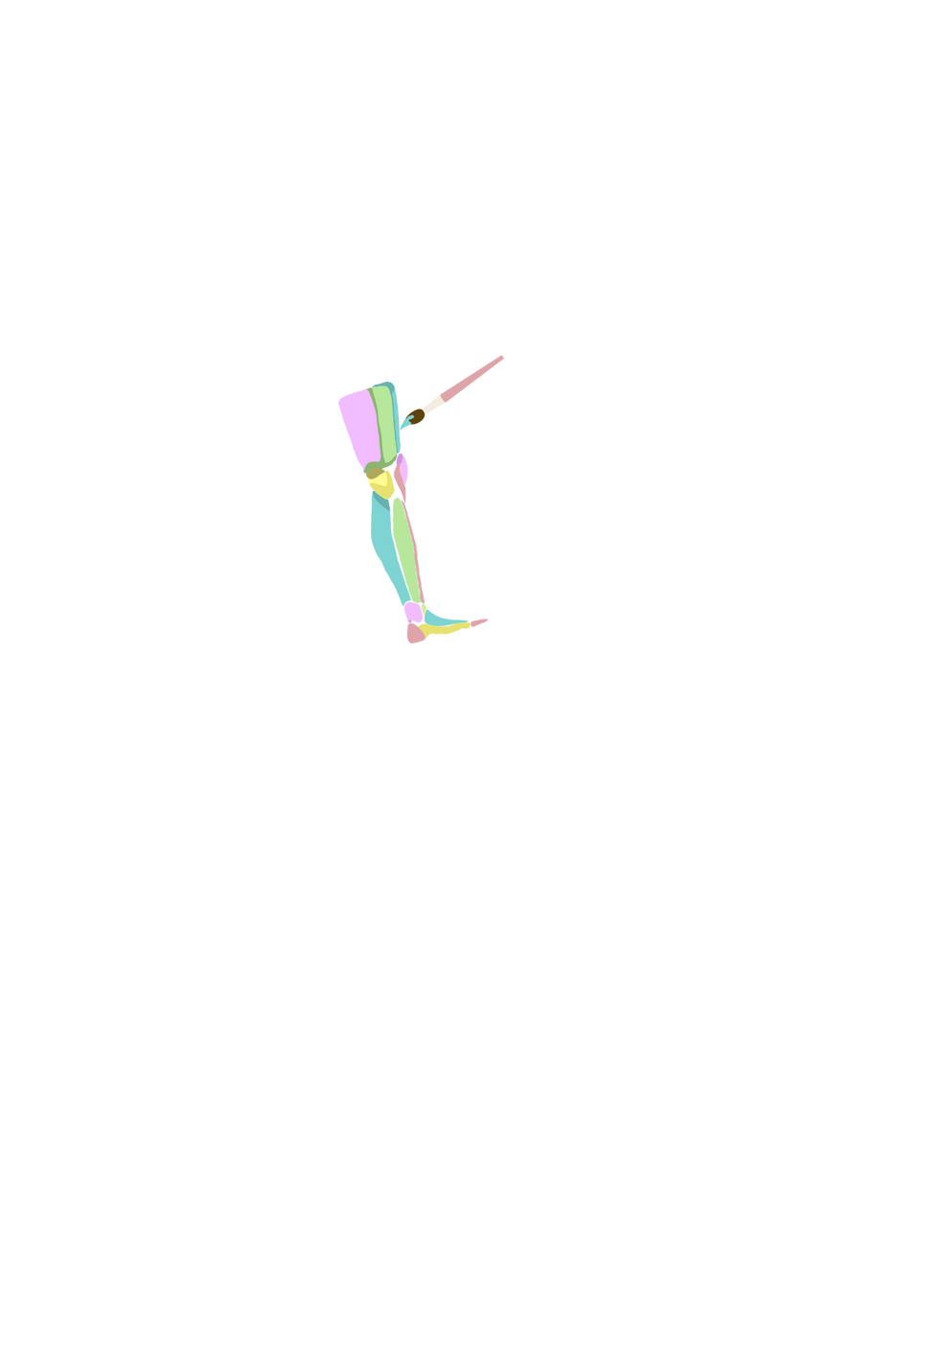



BRINGING COMFORT AND CREATIVITY TO YOUR PROSTHESIS
NOAH DORSEY, JONATHAN FLORES, SKYLAR MCKINNEY, RICH MENDOZA, SAHEL POURFAYAZ

Slide 2
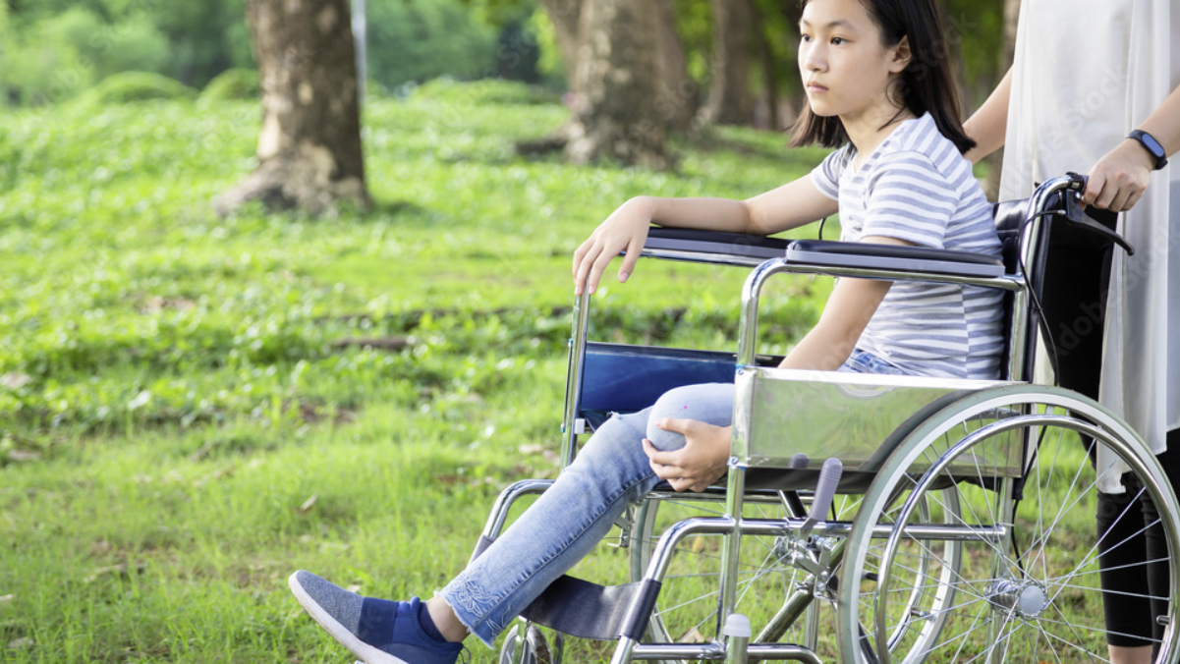

Slide 3


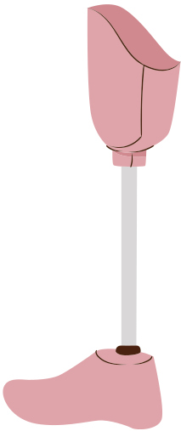

14,081 Children with Lower Limb Deficiencies
Prosthetics and Orthotics International

Slide 4


Slide 5



60%DISSATISFACTION RATE

Slide 6




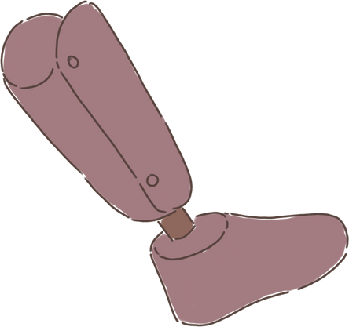
THE PROBLEM
CHILDREN DON'T WEAR
THEIR PROSTHESES
DISLIKED APPEARANCE
POOR FIT/
UNCOMFORTABLE
FUNCTIONALITY

Slide 7


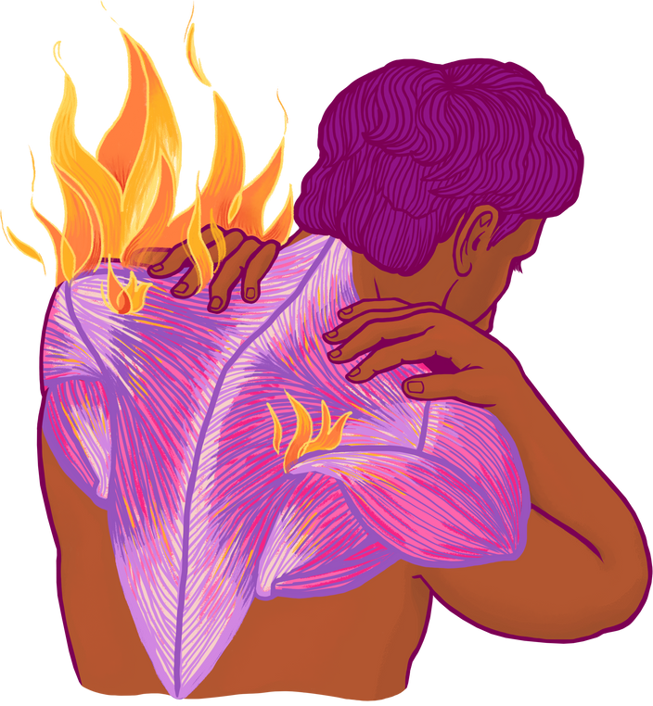
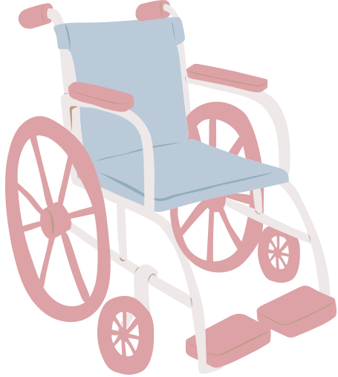

CONSEQUENCES OF NO PROSTHESIS
WHEEL CHAIR USE
2.
REDUCED ACTIVITY
MUSCLE WEAKNESS
WEIGHT GAIN
3.
OVER-RELIANCE ON IN-TACT LIMB
4.
ARTHRITIS CONDITIONS

Slide 8



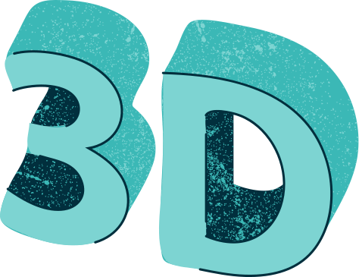

OUR SOLUTION
3D PRINTED PEDIATRIC PROSTHESES
CUSTOMIZATION OF EXTERIOR DESIGN
EMBEDDED IOT MOVEMENT AND INERTIAL SENSORS

Slide 9


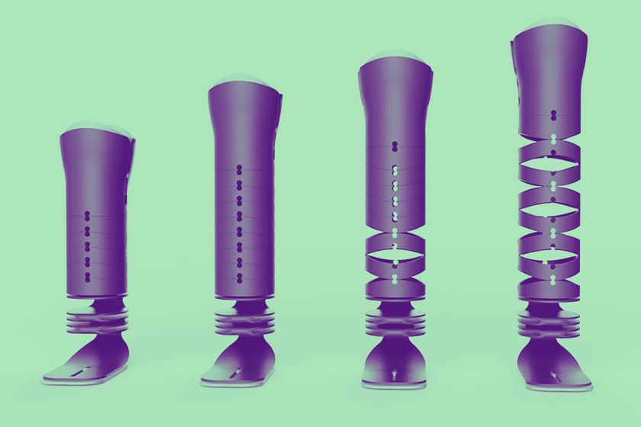



3D PRINTING
MODULAR DESIGN
SEVERAL "BLOCK" EXTENSIONS THAT CAN SECURELY INTERLOCK
ADDED OR REMOVED AS CHILD'S BODY GROWS
POLYCARBONATE MATERIAL
ACCOMMODATE CHANGES IN CHILD'S BODY SIZE
STRONG, DURABLE AND IMPACT RESISTANT

Slide 10

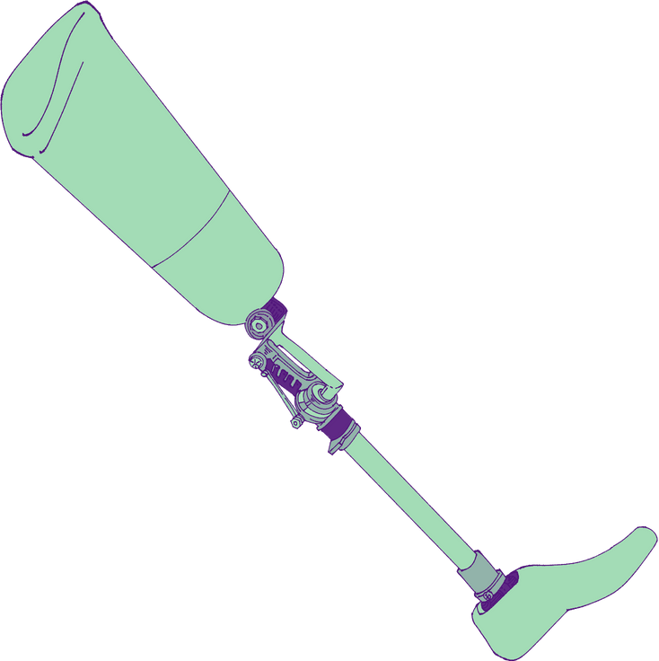



LONG-TERM MONITORING
INERTIAL SENSORS
USE EMBEDDED SENSORS TO ANALYZE THE GAIT, BALANCE, AND PERFORMANCE
IDENTIFY NEEDED ADJUSTMENTS
INERTIAL SENSORS
DATA TRANSMITTED TO OUR COMPANY’S SERVER'S FOR MONITORING OF THE CHILD’S GROWTH

Slide 11
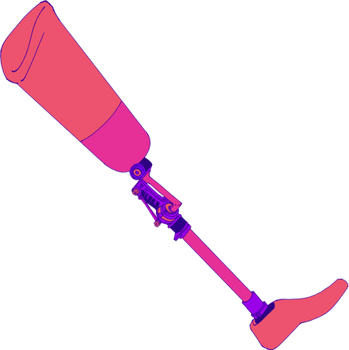
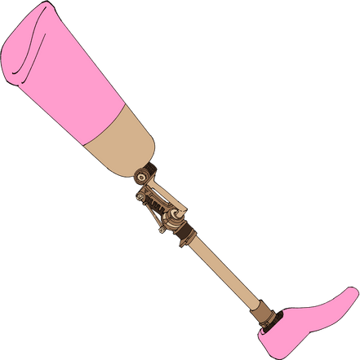
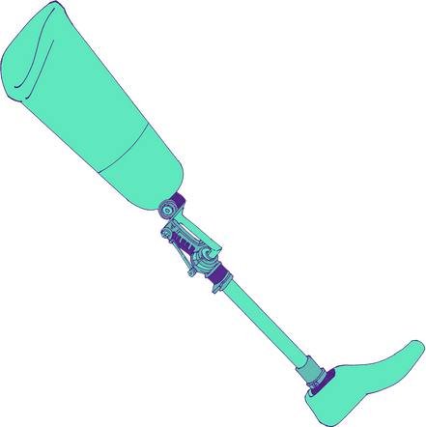
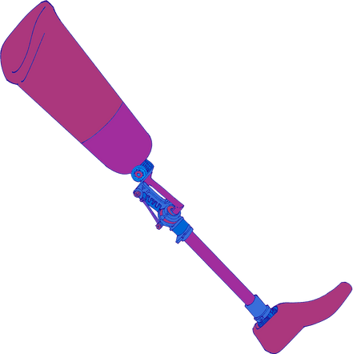
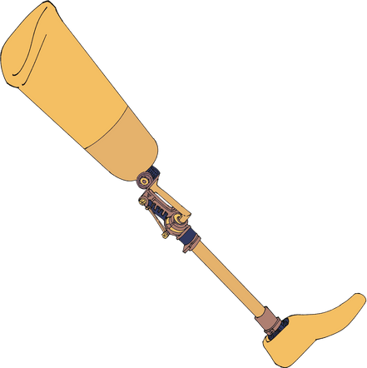


INDIVIDUALITY AND CREATIVITY
CUSTOMIZATION
"MULTICOLOR PRINTING" TECHNOLOGY
ALLOWS PRINTED DESIGNS AND COLORS ON EXTERIOR OF THE PROSTHETIC LIMB
SELF-SERVICE OPTION ON WEBSITE
CHILD CAN PERSONALIZE THE DESIGN, PATTERN OR COLOR OF THEIR PROSTHESES

Slide 12

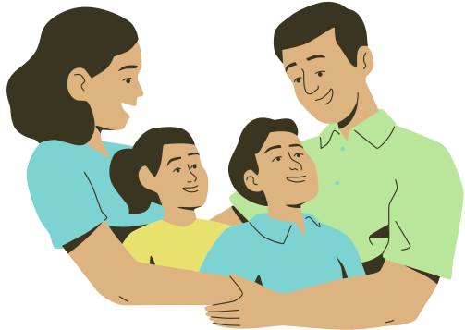
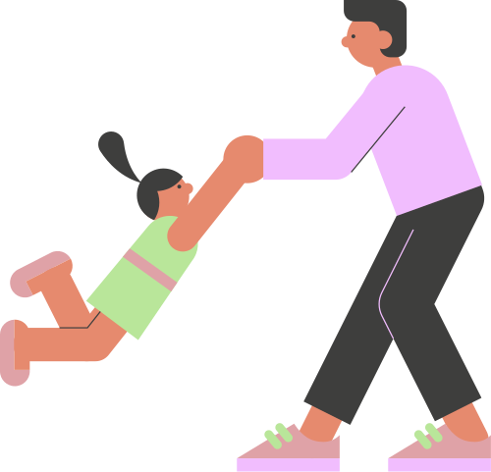
TARGET MARKET
CHILDREN WITH LOWER LIMB DEFICIENCIES

Slide 13
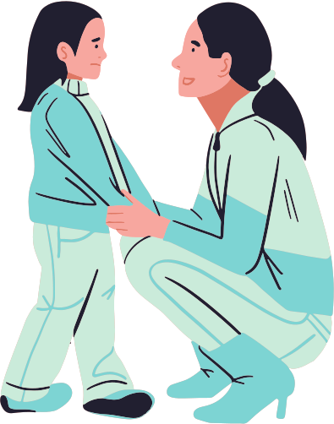
TARGET CUSTOMER
MILLENNIAL PARENTS OF CHILDREN WITH LOWER LIMB DEFICIENCY
LIVING IN COLORADO OR NEIGHBORING STATES
MIDDLE CLASS

Slide 14

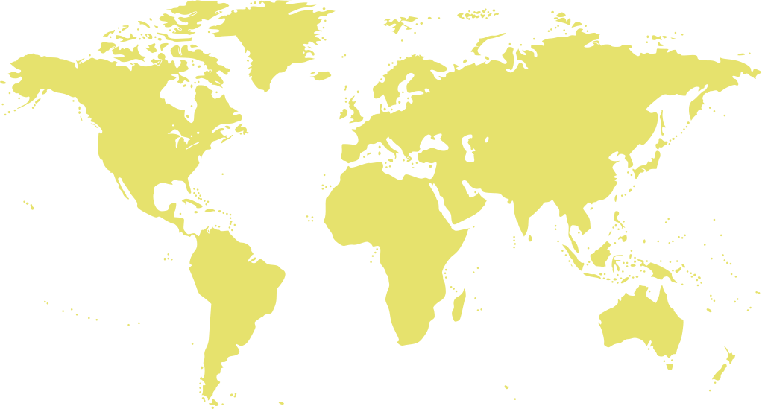
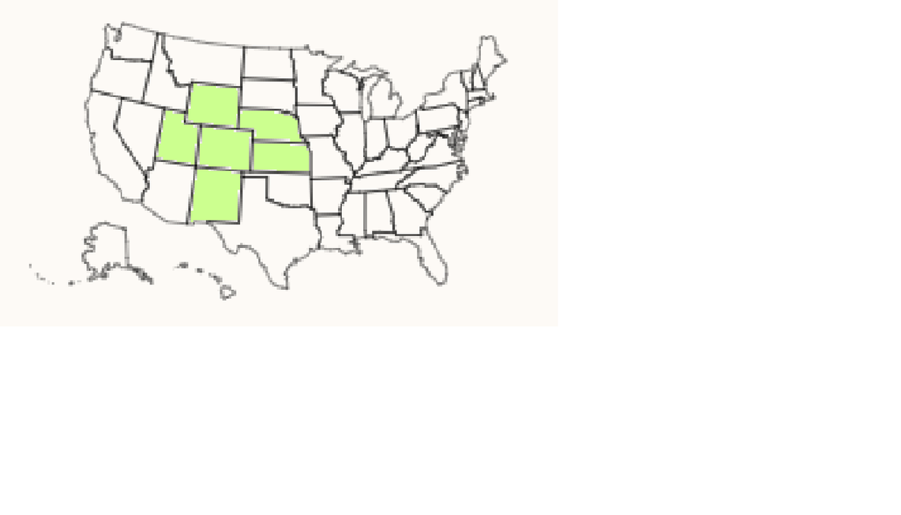
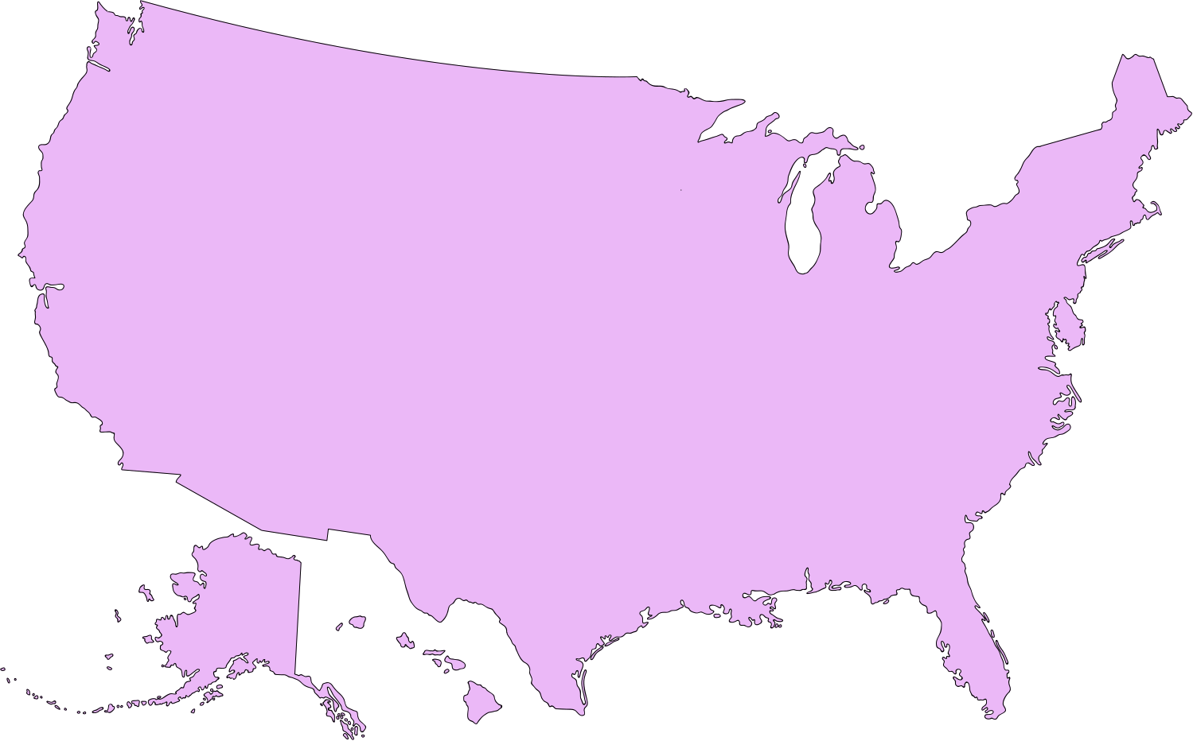
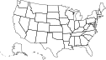

OUR PRODUCT MARKET
TAM SAM SOM
~396,000
14,081
~802
CHILDREN AGES 0-14 WITH LOWER LIMB DEFICIENCY WORLDWIDE
CHILDREN WITH LOWER LIMB DEFICIENCY IN THE UNITED STATES
CHILDREN WITH LOWER LIMB DEFICIENCY IN COLORADO AND NEIGHBORING STATES

Slide 15




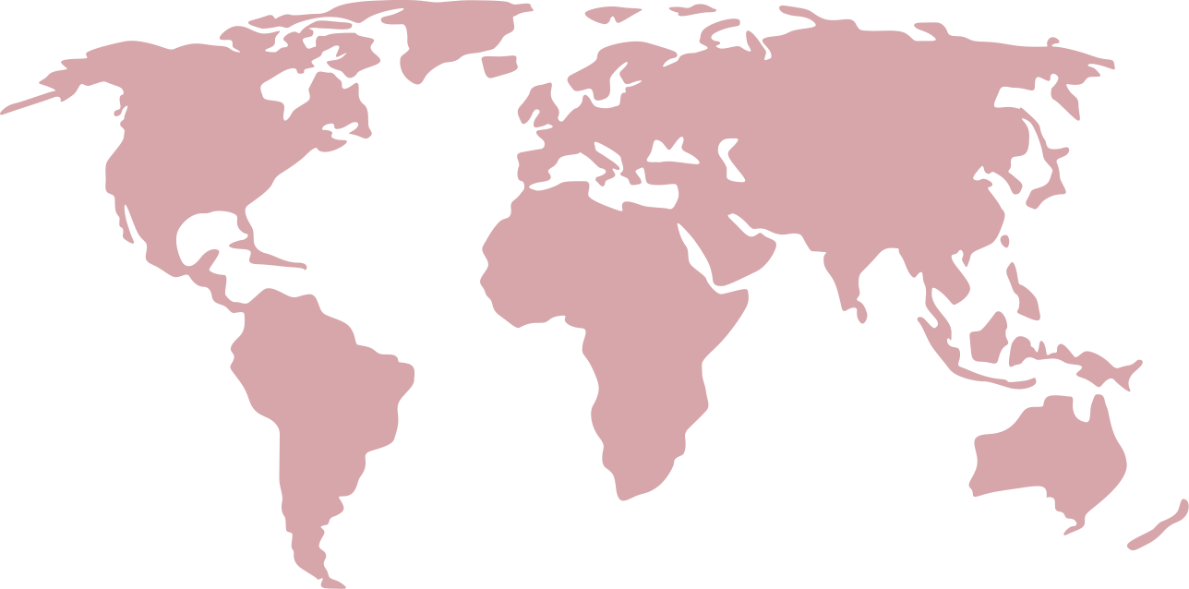
PROTHETICS AND ORTHOTICS
INDUSTRY VALIDATION
$14.3
BILLION EXPECTED REVENUE BY 2023
$14.3
CAGR
4.51%
$9.64
37%
REVENUE SHARE
2022
2021
2030

Slide 16



OUR BUSINESS MODEL
A TWO TIER STRATEGY
BUSINESS TO BUSINESS TO CONSUMER
BUSINESS TO CONSUMER
TIER 1: PRESENT
TIER 2:
FUTURE
UNIT SALE MODEL
SELLING PROSTHETIC DEVICES TO HEALTHCARE COMPANIES
SELLS OUR PROSTHETIC DEVICES TO PATIENTS
PROSTHETIC DEVICE CUSTOMIZED AND PERSONALIZED, SOLD DIRECTLY TO CUSTOMER

Slide 17

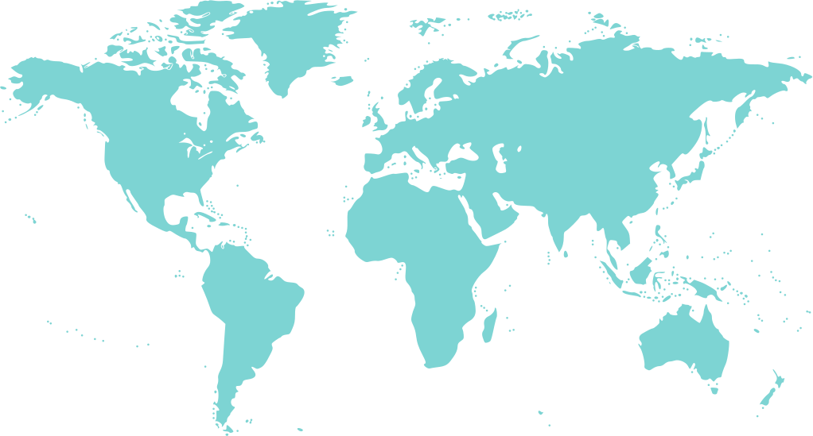

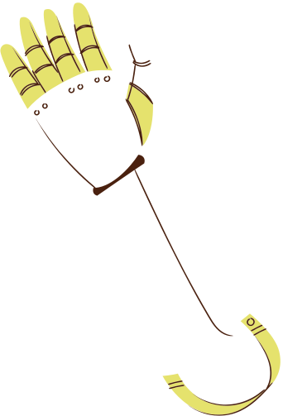

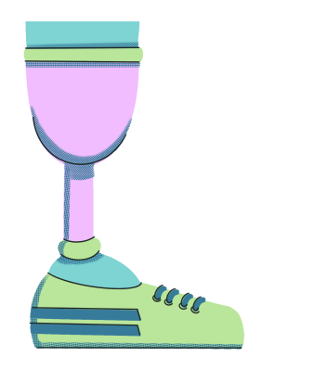
COMPETITION
NOT BASED IN U.S
HUMANITARIAN
FOUNDATION
FOCUS ON PROSTHETIC HANDS

Slide 18



COMPETITION
PRICE
CREATIVITY
MONITORING
E-NABLE
Bionic Arm
Hero ARM

Slide 19

JOIN OUR MISSION TO MAKE EVERY CHILD FEEL PROUD

